Slide 1
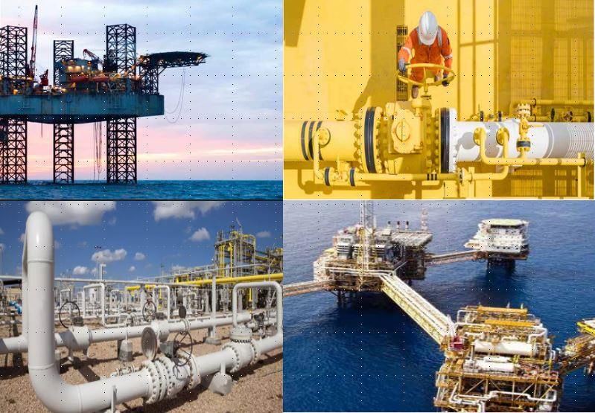
Project Management Consultancy for the
Oil & Gas sector
Control, performance and safety for complex energy investments

Slide 2

PMC offers a wide range of High Value Engineering services:
technical and economic feasibility studies
application of the most advanced Project Management Consulting methods with a new interpretation approach
Our vision is to effectively address current challenges while always looking ahead to propose the best solutions for the future.
We collaborate with investors in the Oil & Gas sector to transform capital into high-performance assets, through disciplined project management, technical excellence, and rigorous control.

Slide 3
P&v - PMC Project Management Consulting
P&V is a Project Management Consultancy (PMC) branch composed of a group of professionals with over 45 years of global experience in project management and corporate performance, united by the same ethical and professional values.
We offer High Value Engineering and Project Management services across various strategic sectors of projects and development.
We act as a trusted representative of the investor, ensuring that every phase of the project—from concept to commissioning—is carried out with precision, transparency, and accountability

Slide 4

Thanks to its exclusive integrated partnership model, PMC offers global and customized solutions, tailored to the specific needs of the client.
Our teams of professionals are specialized by market segments.
Constantly updated and trained on the technical specificities of the relevant sectors, we are able to offer high-quality engineering services at both national and international levels.
We support the development, innovation, and internationalization of knowledge and managerial skills in companies operating in the engineering, Oil & Gas, manufacturing, and construction sectors.

Slide 5
PMC originates from the experience of professionals who have grown within the largest Italian hydrocarbons group, followed by subsequent experiences with other international groups.
We offer technical and managerial consulting services to support any company where a set of multidisciplinary activities constitutes the execution of a project, in the energy, industry, and infrastructure sectors.
The development of a strong Project Management culture and the application of well-established methodologies represent the key to the success of every initiative, in terms of time, cost, and customer satisfaction.

Slide 6
Our leitmotifs are:
the selection of the best technologies
providing support throughout the entire project lifecycle with our methodology
delivering projects focused on sustainability and development from the very beginning of the process through to the realization of the idea
supporting and guiding resources, with the involvement of the final Client, to ensure project delivery and the professional growth of the individuals involved

Slide 7
Our role
We shape and strengthen complex energy projects, supporting investors and companies at every stage with strategic vision and managerial rigor.
We stand out for a discreet yet incisive approach, based on control, transparency, and attention to detail.
We coordinate people, processes, and decisions to ensure smooth and consistent development, in full compliance with quality, time, and investment objectives.
Our value lies in the ability to guide complex initiatives with precision and reliability, transforming them into concrete and lasting results.

Slide 8
Our areas of expertise
Our organization is structured as an integrated platform of specialized competencies, designed to manage complex energy projects at every level.
Integrated Project Leadership: We provide centralized governance, aligning all stakeholders under a single disciplined execution strategy.
Engineering and Technical Authority: From initial design to final validation, we ensure technical integrity, efficiency, and compliance with global standards.

Slide 9
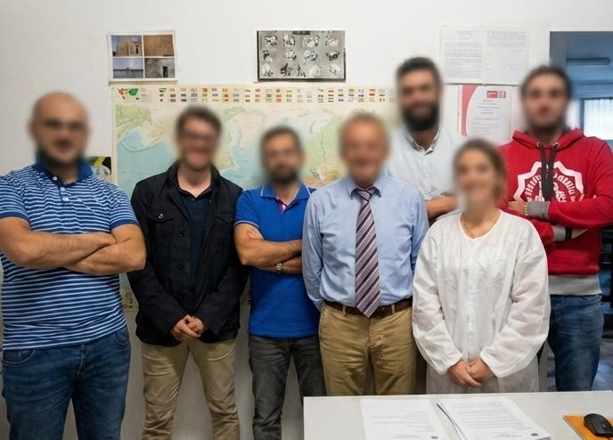
STRUCTURE & ORGANIZATION
Procurement and Commercial Excellence: We manage sourcing, contracts, and supply chain to ensure value, reliability, and cost control.
Construction and Field Execution: Our teams supervise on-site operations, ensuring quality, safety, and adherence to schedules.
Health, Safety and Environmental Protection: We implement strict HSE systems to protect people, assets, and the environment.
Cost and Schedule Control: Through advanced monitoring and forecasting activities, we maintain full financial and schedule control.
Commissioning and Operational Readiness: We ensure a smooth transition from construction to full operation.

Slide 10
The long-standing experience and seniority of the P&V team represent a true guarantee for the realization of both greenfield (new) plants and revamping and expansion interventions on existing facilities.
We provide concrete and highly effective support especially in critical or urgent situations, when during project execution issues arise related to organization, delays, costs, safety, quality, and customer satisfaction.
We also provide specialized assistance in the management of claims and contractual disputes with clients and subcontractors, in relation to variations, time extensions, cost increases, interface responsibilities, unforeseen events, and local constraints.

Slide 11
SKILLS AND SERVICES
We operate globally in the energy, industry, and infrastructure sectors, offering high value-added services within Project Management Culture and Value Enhancement.
We support clients throughout the entire project lifecycle: from feasibility studies to commissioning, start-up, and final handover to the client.
We also support management and professional resources through tutoring, training, coaching, and mentoring activities, with the aim of ensuring continuous improvement of skills.
Our experience shows that a value-oriented approach generates concrete benefits for the organization, people, and clients, in terms of customer focus, professionalism, teamwork, ethics, and innovative capability.

Slide 12
What We Offer to Investors
We support investors with a structured and rigorous approach, designed to protect capital, maximize returns, and ensure full control over every project phase.
The protection of investment is at the core of our operations: through solid governance, proactive risk management, and full transparency, we ensure that every decision is oriented toward capital safeguarding.
At the same time, we work to optimize returns by acting on costs and operational efficiency to concretely improve the overall financial performance of the project.

Slide 13
What We Offer to Investors
Our approach is based on prevention: we identify, analyze, and mitigate technical, commercial, and operational risks in advance, avoiding negative impacts on results and ensuring greater stability for the investment.
Thanks to structured and proven methodologies, we ensure execution certainty, respecting timelines, specifications, and objectives defined from the earliest stages.
We also operate with full independence, providing expert and impartial supervision over all contractors and stakeholders involved, ensuring objective, value-oriented decisions.
Finally, we guarantee full compliance with international standards, local regulations, and environmental requirements, ensuring that every project is aligned with global best practices and regulatory expectations.

Slide 14
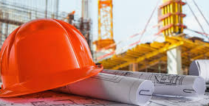
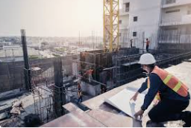
ENERGY / GREEN ECONOMY
Solar and wind energy
Biomass
Geothermal energy
Waste-to-energy
Small hydropower
Hybrid energy systems
Energy storage and management systems
INDUSTRY
Oil & Gas
Petrochemical
Utilities (production and distribution)
Solid handling
INFRASTRUCTURES
Transport systems
Urban development
Traffic planning
Water supply and distribution
Wastewater treatment and disposal
Waste management
Georesources and geotechnics
Real estate

Slide 15
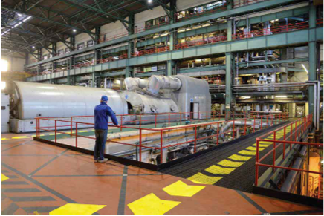
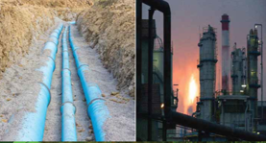
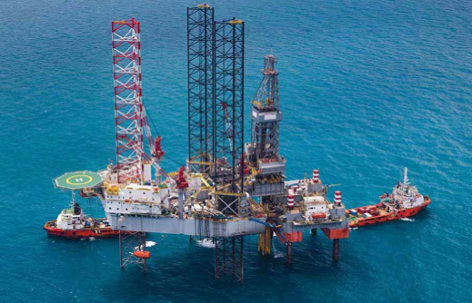
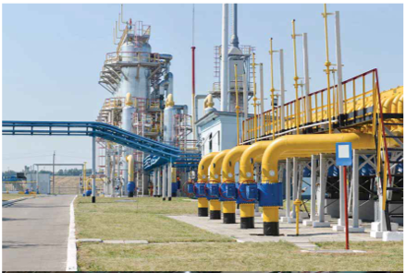
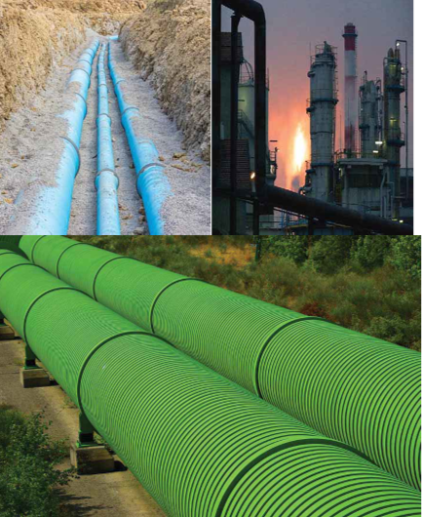
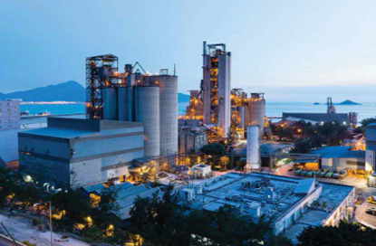
International context
We operate in complex international environments, ensuring compliance with local regulations and global standards.
We adapt our approach to the specificities of each market.

Slide 16




